Slide 1
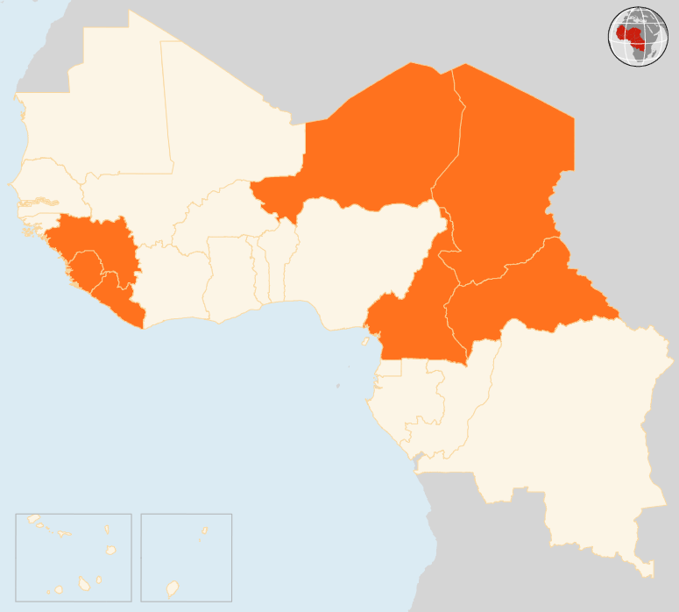

13 - 19 Oct 2015
CAMEROON
OVER 120 killed & 380 INJURED IN TERRORIST ATTACKS IN THREE MONTHS
Between 13 July and October 11 2016, suspected Boko Haram terrorist attacks are reported to have wounded 384 and killed over 120. Hospitals and clinics treating attack victims lack qualified personnel for surgery and medical equipment to adequately respond. In addition, 25 health centres are non-functional due to insecurity, depriving about 83,578 people of health services in the Far North.
CENTRAL AFRICAN REPUBLIC (CAR)
RENEWED VIOLENCE IN BANGUI LEAVES 1 DEAD AND 10 INJURED
On 15 October, at least one person was killed and 10 injured in fresh sectarian clashes in the largely Muslim district of PK-5 in Bangui. Thousands of residents were forced to flee to other parts of the city. Many returned to their homes the next day as calm was restored. The security situation in the capital remains relatively calm but unpredictable since 6 October. Socio-economic activities are slowly normalizing but, although the academic year was launched on 21 September, schools yet to reopen. Outside the capital, tensions also persist in some regions.
CHAD
CHRONIC MALNUTRITION AFFECTS THOUSANDS
In Bokoro, in the Lake Chad basin, an MSF emergency team is responding to a nutrition crisis, treating more than 2,300 severely malnourished children since July. Earlier in June MSF assessed that 5.5% of children under the age of five were suffering from severe acute malnutrition - more than twice the emergency threshold of 2%. This year, insecurity and violence around Chad’s borders have also disrupted trade, which has negatively affected the fragile local economy and the availability of food. According to the Nutrition cluster, the expected numbers of malnutrition cases for the year 2016 is 321,473 children in severe acute malnutrition and 398,842 in moderate acute malnutrition.
NIGER
15 DAY STATE OF EMERGENCY IN DIFFA
Following recent attacks perpetrated by suspected Boko Haram elements over the past weeks, the Government of Niger has declared a 15-day state of emergency on the southern region of Diffa. This security measure includes a curfew and restrictions on the movement of goods and people. This is the second time that the Government imposes a state of emergency in the Diffa region. The first one was declared in February and lifted on 4 September 2015.
REGIONAL/ EBOLA VIRUS DISEASE (EVD)
2 OUT OF 3 NEW CASES IN GUINEA ARE NOT FROM KNOWN CONTACTS
Three new cases were reported in Guinea in the week ending Sunday 18 October, after two weeks without new cases of Ebola virus disease. The first case is a 21-year old male from Ratoma, Conakry. The second case is a 35-year old woman from Koundouya village in Forécariah. Neither case was a registered contact therefore epidemiologists will have to widen contact tracing and determine the origin and reach of two possible new chains to expand surveillance and reinforce prevention. The third case is the 3-month old daughter of the second case. There were zero cases reported in Sierra Leone and in Liberia.
NIGER
15
DAYS STATE OF EMERGENCY IN DIFFA
CHAD
CHRONIC MALNUTRITION CONTINUES
CAR
1
KILLED IN ATTACKS IN BANGUI
EVD REGIONAL
3
NEW CASES IN GUINEA
CAMEROON
OVER 120 KILLED & 380 INJURED IN TERRORIST ATTACKS SINCE MID-JULY
Creation date: 20 October 2015 Map data sources: UNCS, DevInfo, OCHA. Feedback: ocharowca@un.org
The boundaries and names shown and the designations used on this map do not imply official endorsement or acceptance by the United Nations.

